Slide 1

Modern DevOps
Bridging the Gap Between Development and IT Operations
INTRODUCTION & BEST PRACTICES

Slide 2


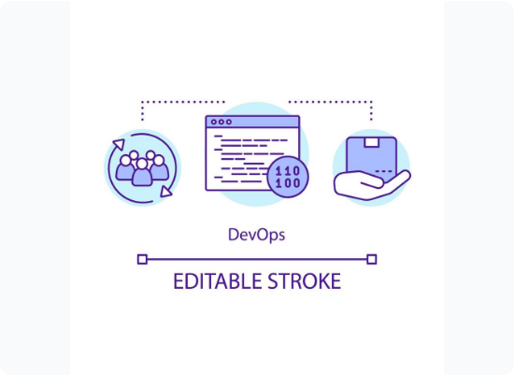
Defining DevOps
Unified Culture
DevOps is a set of practices that combines software development (Dev) and IT operations (Ops).
It aims to shorten the systems development life cycle and provide continuous delivery with high software quality.
Goal: Merge the "speed" of developers with the "stability" of operations teams.

Slide 3






The DevOps Pipeline: Four Pillars
CI
CD
CDp
CM
Continuous Integration: Merging code changes into a shared repo frequently to trigger automated builds.
Continuous Delivery: Ensuring the code is always in a deployable state to a production-like environment.
Continuous Deployment: Automatically pushing every change that passes the pipeline into production.
Continuous Monitoring: Real-time tracking of application performance and user behavior.

Slide 4

The DevOps SDLC
A Continuous, Circular Journey

Slide 5
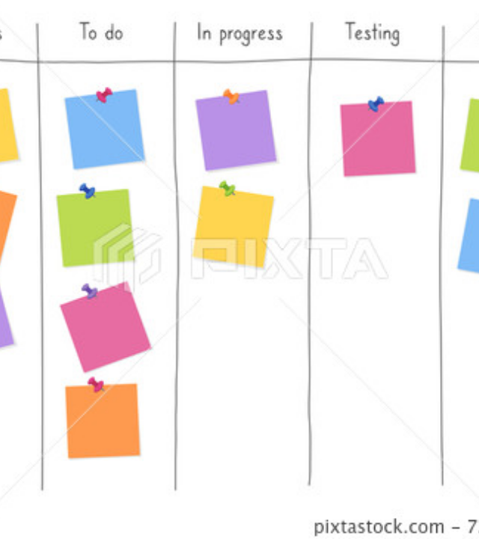
1. Plan
Continuous Planning
DevOps planning happens in small, iterative chunks (Sprints) rather than massive upfront documents.
DevOps Twist: Heavy emphasis on "Shift Left"—discussing security and operations requirements during the initial phase.

Slide 6
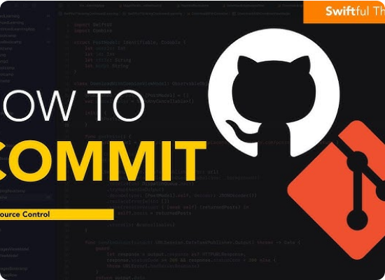
2. Code (Develop)
Small Increments
Developers write code in manageable pieces and merge frequently into a shared repository.
DevOps Twist: Version Control Systems (like Git) are non-negotiable. Merging occurs multiple times a day to prevent "integration hell."

Slide 7
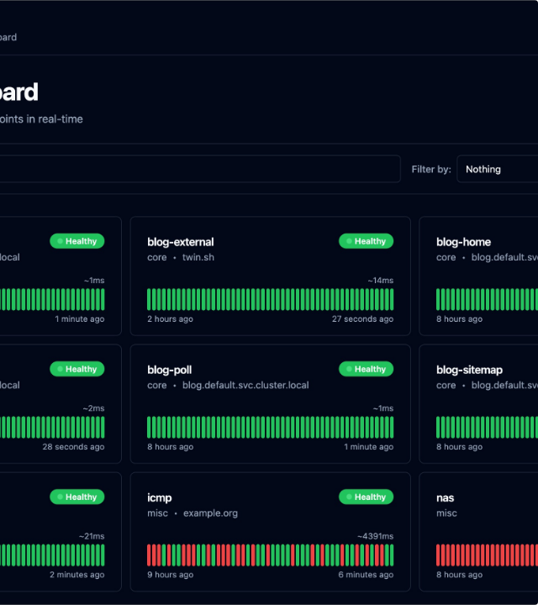
3. Build & Test (CI)
The Heartbeat
As soon as code is committed, an automated "Build" is triggered to compile code and resolve dependencies.
DevOps Twist: This is the CI heart. If a build fails, the team is notified immediately, keeping the main branch stable.

Slide 8
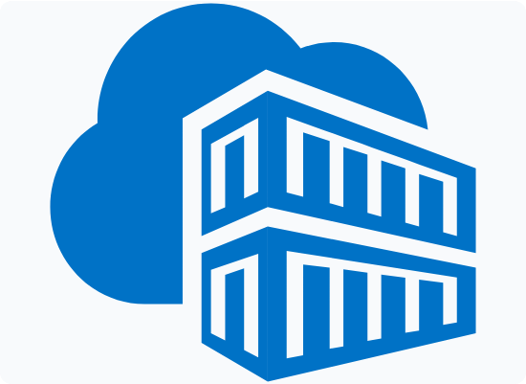
4. Release (CD)
Boring is Good
Once tests pass, the code is packaged as an artifact (e.g., Docker container) and stored in a registry.
DevOps Twist: Releases should be predictable and "boring" because they've been automatically validated multiple times.

Slide 9
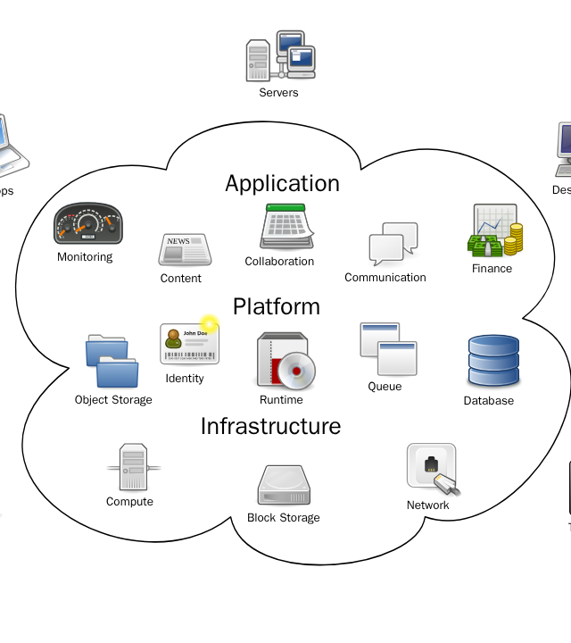
5. Deploy
Pushing to Production
Software is moved from staging to the live environment where actual users can access it.
DevOps Twist: Utilizing Infrastructure as Code (IaC) to ensure environments are identical every time, eliminating configuration drift.

Slide 10
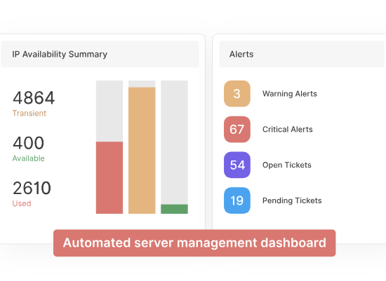
6. Operate
Maintenance & Scale
Maintaining software health, managing server resources, and ensuring high availability for global users.
DevOps Twist: Ops teams use automation for configurations and patching rather than manual server updates.

Slide 11
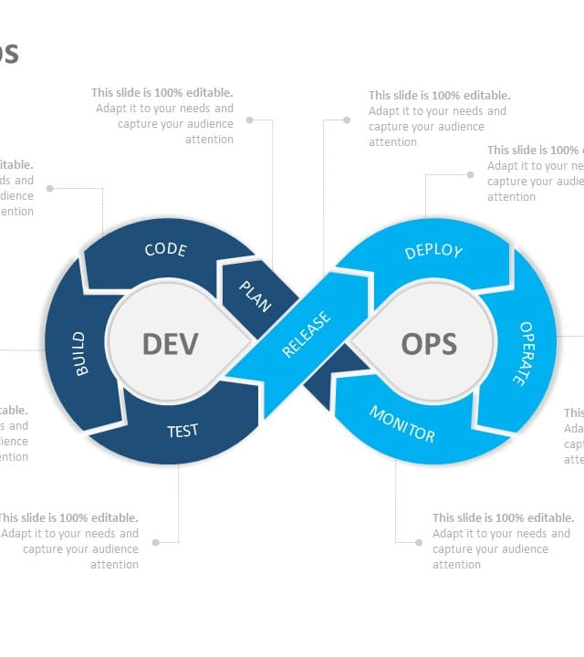
7. Monitor & Feedback
Closing the Loop
Data is collected on application performance, errors, latency, and user behavior in real-time.
DevOps Twist: This data provides a direct Feedback Loop to the Plan phase for the next iteration of the software.

Slide 12
Traditional vs. DevOps SDLC
Feature | Traditional (Waterfall) | DevOps SDLC
Structure | Linear / Sequential | Continuous / Circular
Release Frequency | Months or Years | Days or Hours
Feedback | At the very end | Constant and immediate
Testing | Separate phase after coding | Automated & Integrated throughout
Collaboration | Siloed (Dev vs. Ops) | Unified Shared Responsibility

Slide 13
Advanced Testing Strategies
Building Quality from the Foundation Up

Slide 14
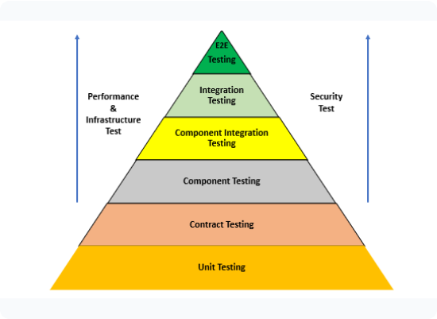
The Testing Pyramid
Hierarchy of Automation
The pyramid analogy suggests that a healthy testing suite should have a broad base of unit tests.
E2E (Top): Smallest amount. High cost, slow, fragile.
Integration (Middle): Moderate amount. Validates component interaction.
Unit (Base): Largest amount. Fast, reliable, cheap.

Slide 15






Types of Automated Tests
Unit Tests
Integration
End-to-End
Testing individual functions or methods in isolation. The fastest feedback loop for developers.
Verifying that different modules or services work together correctly (e.g., API to Database).
Simulating real user scenarios from start to finish across the entire system stack.

Slide 16
Clean Code Principles for Testing
SoC
SRP
Separation of Concerns: Distinct sections should handle distinct functionalities.
Single Responsibility Principle: A module or class should have one, and only one, reason to change.
By separating logic from UI or data access, we can test business rules without launching a heavy browser or database.
Testing becomes trivial because there are fewer dependencies to mock and scenarios to cover.

Slide 17

The Cost of Bad Code
The Testing Nightmare
Failing to adhere to SRP and SoC leads to "God Objects"—classes that do everything.
The Downside:
•
Extremely fragile tests that break with any change.
•
Impossible to mock dependencies effectively.
•
Technical debt that slows down the entire CI/CD pipeline.

Slide 18
Why DevOps Matters: The Impact
High Performance Results
208x
According to DORA metrics, high-performing DevOps teams achieve significantly faster lead times and lower failure rates.
More Frequent Deploys
They recover from incidents 2,604x faster than low performers, proving that speed and stability can co-exist.

Slide 19
Key Takeaways for Success
Automate Everything: From builds to infrastructure, manual steps are the enemy of scale.
Shared Responsibility: Dev and Ops are one team; everyone owns the software's uptime and quality.
Small Batches: Deploy smaller changes more often to reduce risk and simplify troubleshooting.
Measure What Matters: Use monitoring to drive your planning—data should always beat intuition.

Slide 20
Summary & Questions?

